Slide 1
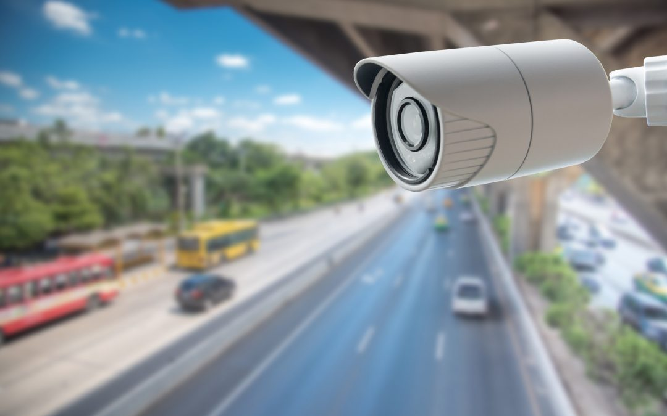
Red Traffic light violation monitor

Slide 2
Do you know how many people die in traffic

Slide 3
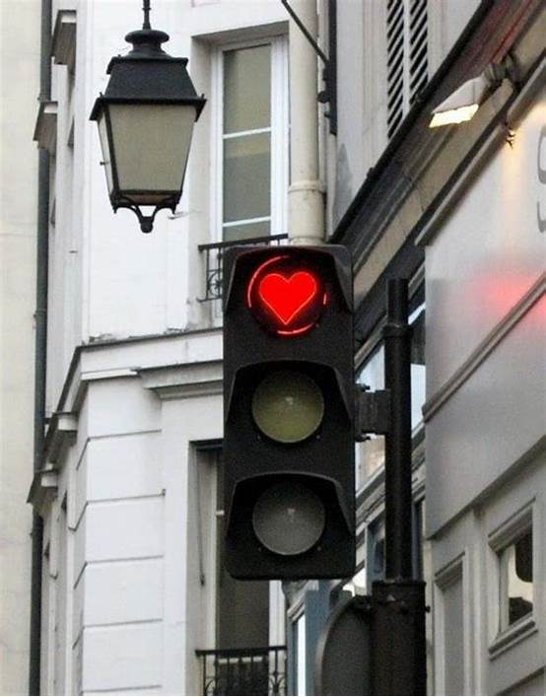
AGENDA
Introduction
How it works
Challenges
properties
Future Expansion
Conclusion

Slide 4
introduction
Why we need the RTVD
traffic management
law enforcement
public safety
Need
real-time video feeds or traffic cameras

Slide 5
How it works (Technical Workflow)
Video Input: Captures live video feed from traffic cameras
Violation Detection: Real-time processing using YOLO model
Alert Generation: Automatically generates violation reports (image)
Integration: The system can connect with local law enforcement databases

Slide 6
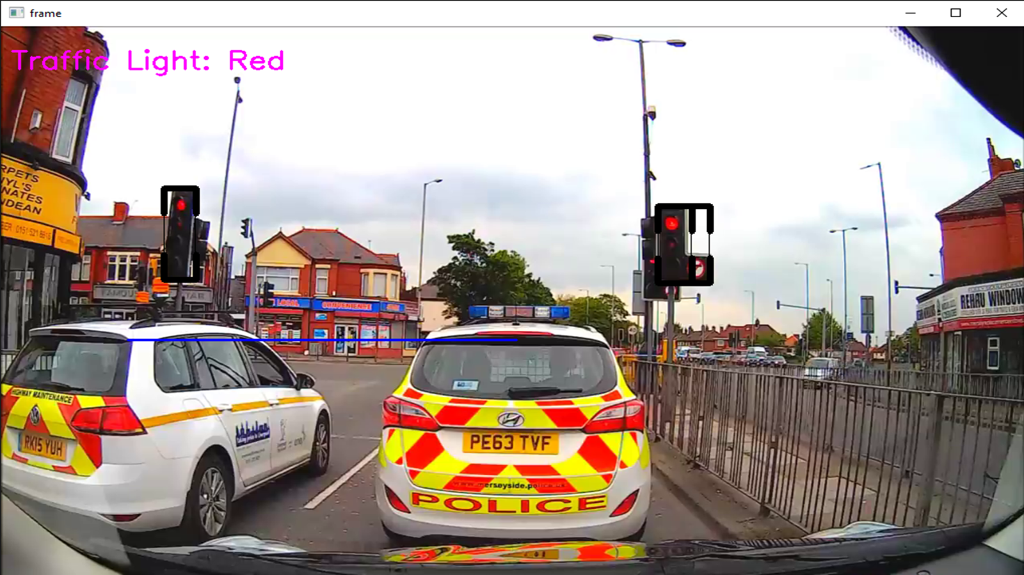
Traffic detection

Slide 7
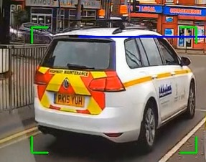
Car detection

Slide 8
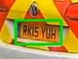
Car detection

Slide 9
challenges
Gathering Data
Red Traffic Detection
Model Accuracy
OCR Type

Slide 10
Gathering data
One of the main challenges faced during this project was the difficulty in gathering relevant videos and image data for training the model.
Limited availability: High-quality datasets for detecting red-light violations is limited.
Scattered sources: Data was not centralized, requiring manual collection from multiple platforms.
Overcome
To overcome this, I explored various sources to collect diverse and reliable data
Like Google Images Open Image Dataset Kaggle Datasets Free Stock Footage Sites

Slide 11
Red traffic detection
the system struggled to accurately detect the red color in traffic lights due to interference from other elements in the frame (e.g., vehicles, background).
overcome
Separated the traffic light from the rest of the frame by focusing only on the region of interest (the traffic light).
Created a black image with the same dimensions as the original frame.
Drew a white rectangle over the region where the traffic light is located, on the black image.
Applied a bitwise multiplication between the black image and the original frame. This operation isolates the traffic light, excluding all other irrelevant objects from the frame.
Converted the result to grayscale, allowing the system to focus solely on the color of the light (red, yellow, green) and perform accurate recognition.

Slide 12
Model accuracy
The YOLOv8 model initially gave low accuracy in detecting car license plates, likely due to insufficient training data and suboptimal model performance.
Overcome
Collected a specialized dataset of car license plates, ensuring diversity in angles, lighting conditions, and plate designs.
Optimized the model by adjusting the weights to better fit the collected data, making it more sensitive to the nuances of license plates in various environments.
Pretrained the YOLO model on this new dataset, improving its ability to accurately detect and identify license plates in real traffic scenarios.
Outcome: This optimization resulted in significantly higher detection accuracy and overall system reliability.

Slide 13
Ocr type
The initial OCR tools used, like PytesseractOCR, gave poor accuracy in recognizing the text on license plates due to varying image quality, lighting, and resolution.
Overcome
Experimented with different OCR tools, including EasyOCR and OpenCV's OCR, but encountered similar accuracy issues.
Finally chose PaddleOCR, which incorporates advanced image preprocessing algorithms, such as image enhancement and noise reduction, to improve the quality of the image before text extraction.
This resulted in more reliable and accurate recognition of license plate text, even in challenging conditions.

Slide 14
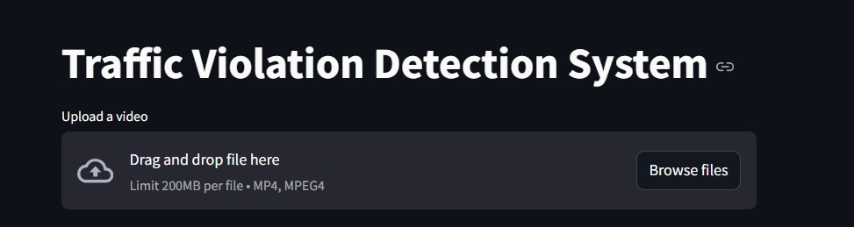
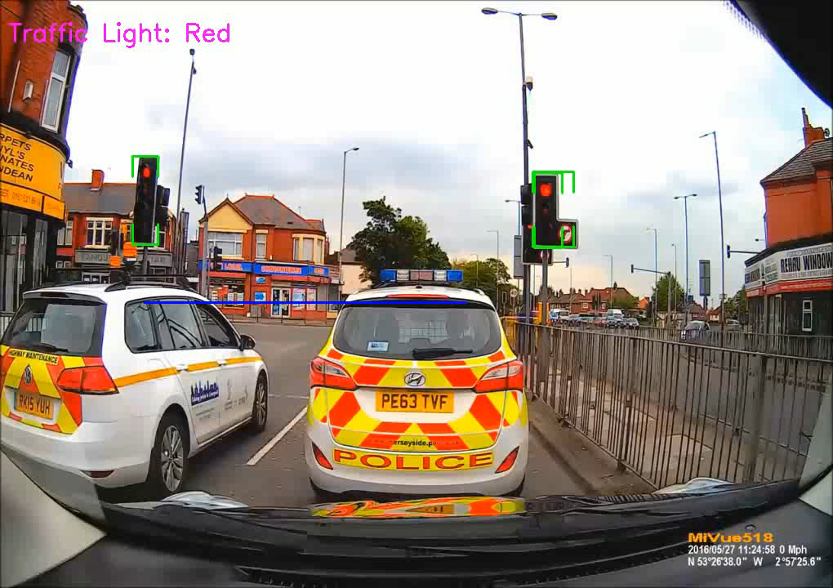
Video Input
Browse your video her
In case real-time video, automatically connect with project

Slide 15
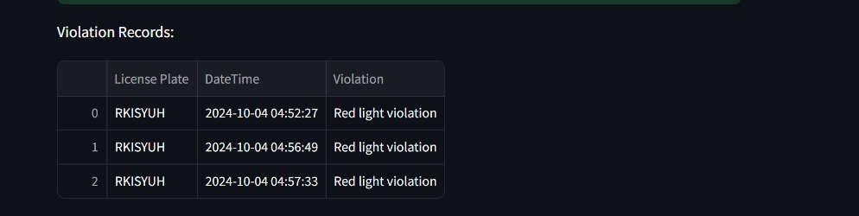
Integration with system
After capturing, detect the license number of car and store in data base

Slide 16
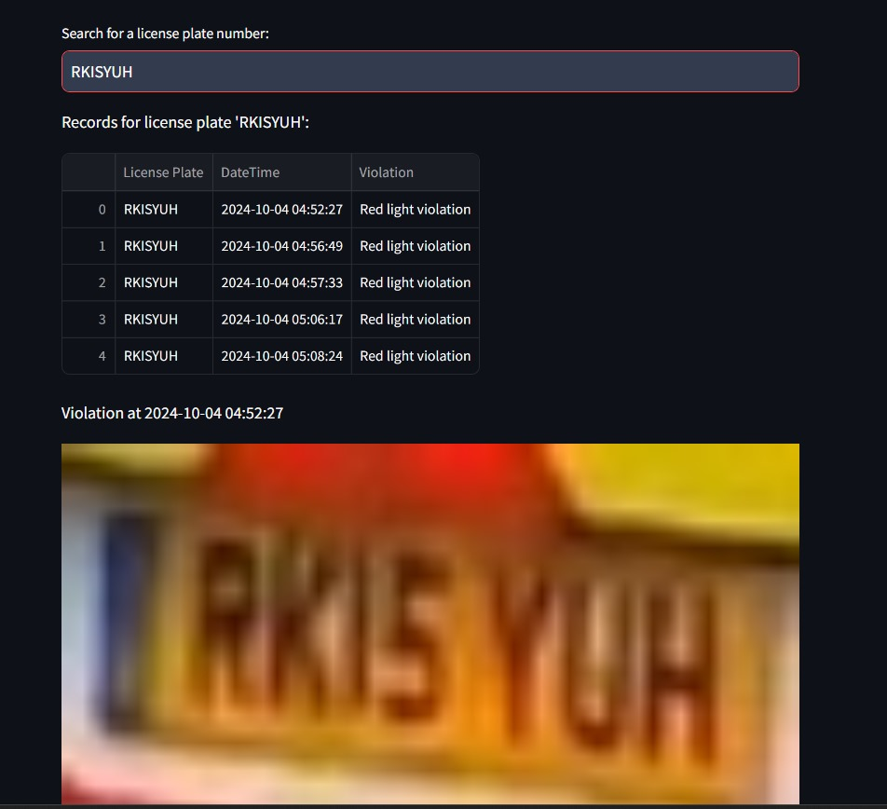
Report generation
Capture the image of car license and sent it or store in the database with the time of violation

Slide 17
properties
Impact
Advantages
Opportunity & Strategy

Slide 18
Impact
Improved Law Enforcement
Automates red light monitoring, reducing the need for manual enforcement at every intersection.
Cost Savings
Reduces operational costs by eliminating the need for human officers to monitor intersections.
Revenue Generation
Increased detection leads to more fines, which can fund further traffic management initiatives.
Safety Improvement
Preventing accidents by encouraging drivers to comply with traffic signals.
Long-term Benefits
Fewer accidents, leading to lower costs related to emergency services and traffic congestion.

Slide 19
Advantages
Real-time Detection
Detects violations as they happen, ensuring immediate action can be taken.
High Accuracy
Reduces false positives using state-of-the-art computer vision techniques (models like YOLO).
Scalability
Can be deployed citywide or in specific traffic-heavy areas without extensive infrastructure changes.
Customizability
Can adapt to local traffic rules and integrate with existing traffic systems.

Slide 20
Opportunity & Strategy
Smart Cities: The system aligns with the growing trend of smart cities where automation and AI improve urban living.
Law Enforcement Agencies: Key users of the system for monitoring and enforcing traffic violations.
Insurance Companies: Data from the system could help in analyzing accident causes and insurance claims.
Pilot Deployment: Test the system at a few high-traffic intersections for initial validation.
Full-Scale Deployment: Expand the system across the city or region once tested and refined.
Collaboration: Work with traffic authorities, law enforcement, and local governments for smooth integration and data sharing.

Slide 21

Future Expansion
Additional Violations: Expand the system to detect other types of violations such as speeding, illegal lane changes, and distracted driving.
AI Enhancements: Incorporate AI to predict and prevent potential accidents based on traffic patterns and driver behavior.
Integration with Autonomous Vehicles: As smart cars become more common, the system can communicate directly with vehicles to prevent violations.

Slide 22
Team behind the scenes
The Red Traffic Light Violation Detection System demonstrates how advanced computer vision and machine learning techniques can be applied to solve real-world problems. Through careful problem-solving, including the isolation of traffic lights, optimizing the YOLO model for license plate detection, and using PaddleOCR for text recognition, the system significantly enhances the accuracy and reliability of detecting traffic violations.
This project not only improves traffic law enforcement but also contributes to overall road safety. As the system continues to evolve, it holds the potential for broader applications in smart cities and integrated traffic management solutions.
Conclusion
Ahmed ashour
Abd-alrahman helal
Andrew morris
Ahmed fath elbab
Mohamed essam
Ahmed Mahmoud

Slide 23

THANKs
Eng/ Walaa Khaled
DEPI Organisers and Managers

